Slide 1
Crimson Clubs
Adam Gabriel, Max Livingston, Travis Redfield, Maclane May, Taylor Meads

Slide 2
Review
App/Website
Allows students to manage their clubs and teams
Can work for clubs/intramurals/informal groups

Slide 3
Definitions
Admin User – Club leaders, officers, faculty advisors, etc.
Standard User – A normal user with normal privileges.

Slide 4
Functional Requirements (Admin)
Add other people/Approve people (Required)
Create Events (Required)
Push Notifications (Required)
Remove People (Required)
Modify Description/Info/Tags (Required)
Add Stats (Low)
Referee Tools (Future)

Slide 5
Functional Requirements (Normal)
Request to Join Club/Join Club (Required)
Search Clubs (Required)
Look at Personal Calendar (Required)
Leave Clubs (Required)
Look at info (Required)
Create Profile (Possible)
View Event Stats/Leagues (Low)

Slide 6
Non-Functional Requirements
Login (Required)
Save to database (Required)
Flexible UI for website and app (Required)
Profile Management (Possible)
Search Algorithm based on Profile/Tags (Low)
Integration with standard phone calendar (Future)

Slide 7
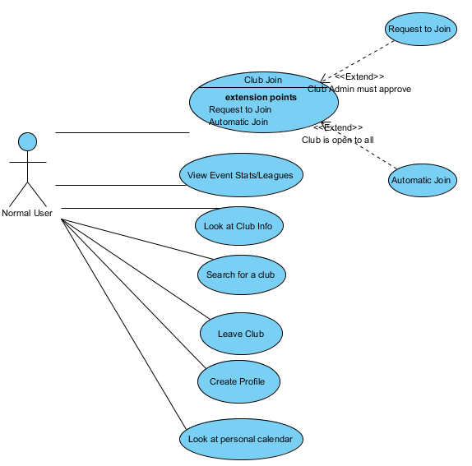
Normal User Use Case Diagram

Slide 8
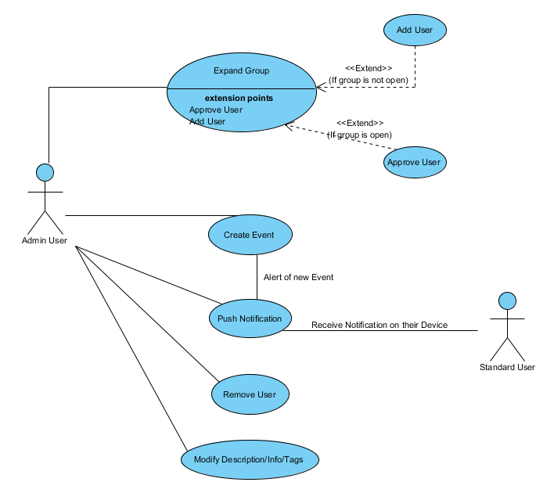
Admin User Use Case Diagram

Slide 9
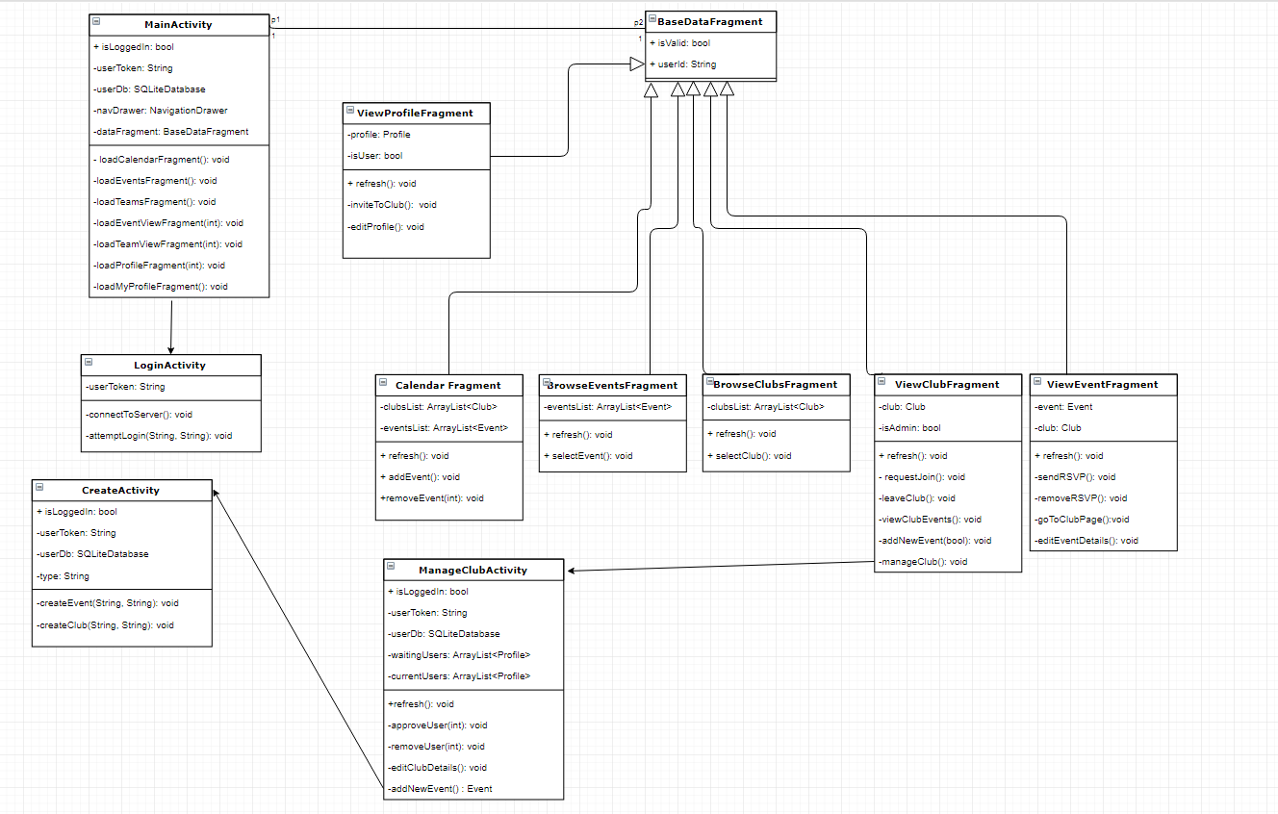
Class Diagram

Slide 10
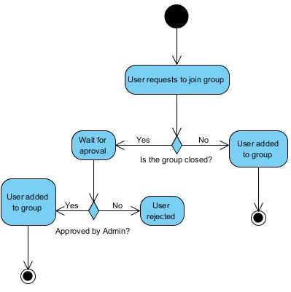
Add User

Slide 11
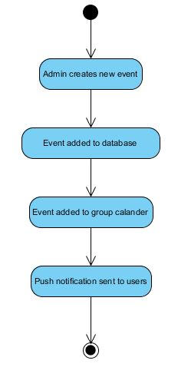
Create Event

Slide 12
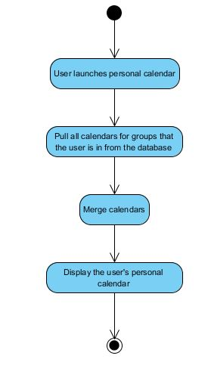
Display Personal Calendar

Slide 13
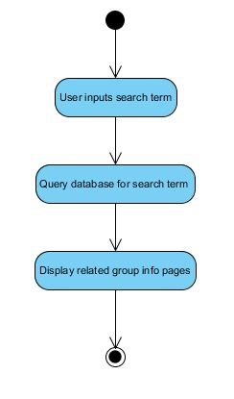
Search Clubs

Slide 14
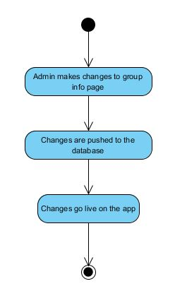
Update Club Info

Slide 15
Website
The frontend website will use AJAX calls instead of form submissions.
The backend will be C# .NET using MVC.
The database with be T-SQL.

Slide 16
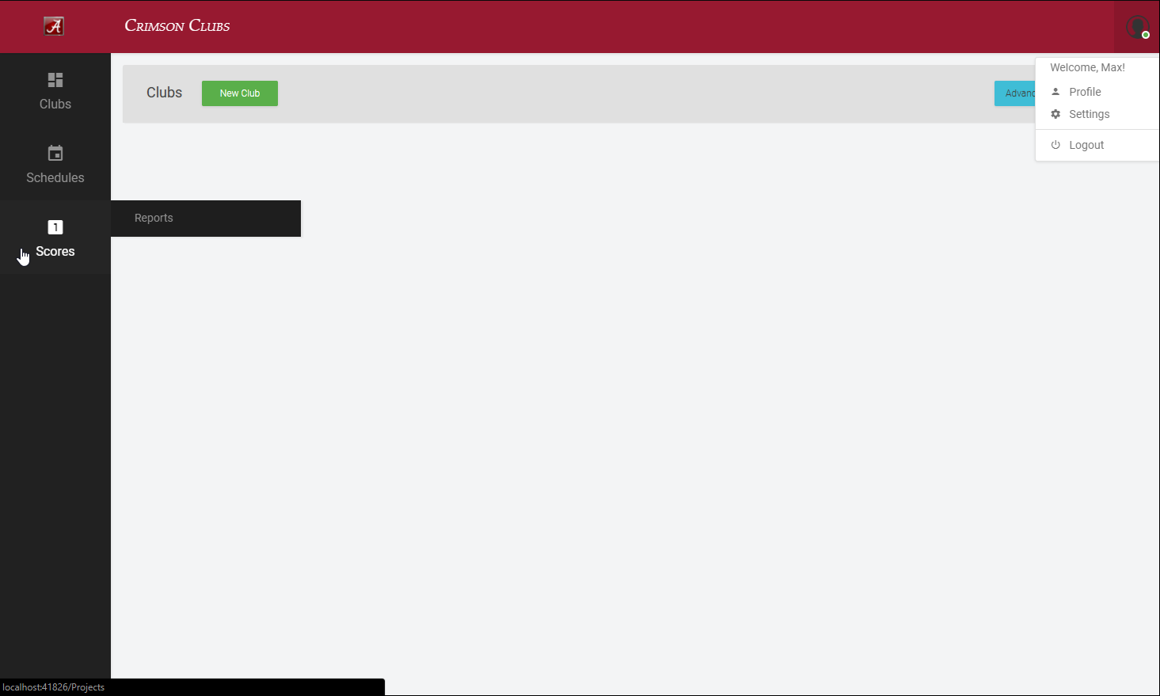

Slide 17
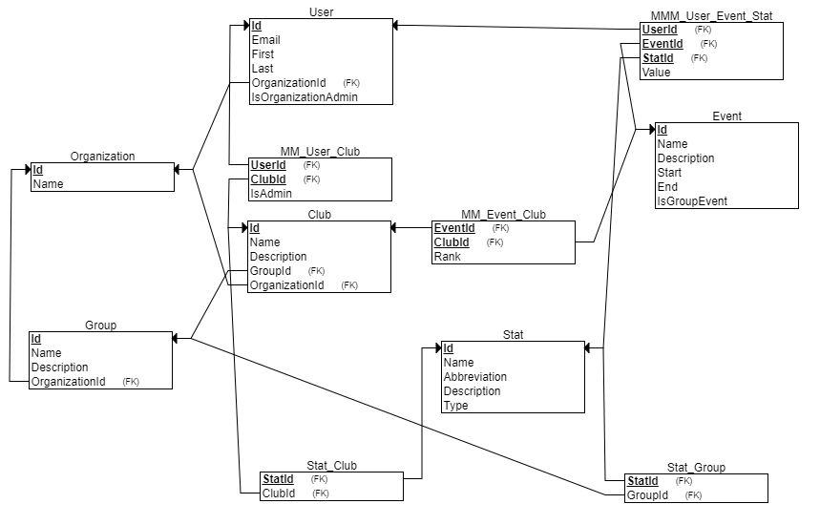

Slide 18
Potential Risks
Security (login and personal information)

